Slide 1

Mobile Application Development
Welcome
Class: BS(CS)-VII
Sukkur IBA University – Kandhkot Campus
Week - 05
Lecture – 10
Your Facilitator, Adil Khan

Slide 2
Shared Preference

Slide 3
What is Shared Preferences?
Read and write small amounts of primitive data as key/value pairs to a file on the device storage (For managing large amounts of data, use an SQLite database or other suitable storage option).
SharedPreference class provides APIs for reading, writing, and managing this data.
The Android framework manages the shared preferences file itself. The file is accessible to all the components of your app, but it is not accessible to other apps (Data is private to the application).

Slide 4
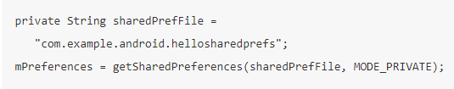
Creating a Shared Preferences file
Need only one Shared Preferences file per app
Name it with package name of your app—unique and easy to associate with app
You create the shared preferences file in the onCreate() method of your main activity and store it in a member variable.

Slide 5
Creating a Shared Preferences file
MODE argument for getSharedPreferences() is for backwards compatibility—use only MODE_PRIVATE to be secure.
If you need to share data with other apps, use a service or a content provider.

Slide 6
Saving Shared Preferences
You save preferences in the onPause() state of the activity lifecycle using the SharedPreferences.Editor interface.
Get a SharedPreferences.Editor. The editor takes care of all the file operations for you.
Add key/value pairs to the editor using the "put" method appropriate for the data type, for example, putInt() or putString(). These methods will overwrite previously existing values of an existing key.
Call apply() to write out your changes. The apply() method saves the preferences asynchronously, off of the UI thread.

Slide 7
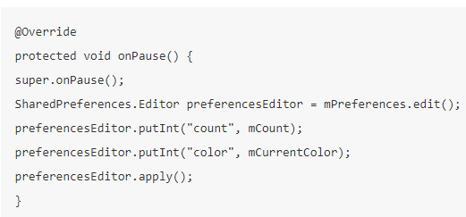
Saving Shared Preferences

Slide 8
Restoring Shared Preferences
You restore shared preferences in the onCreate() method of your activity.
The "get" methods such as getInt() or getString() take two arguments—one for the key and one for the default value if the key cannot be found.
Using the default argument, you don't have to test whether the preference exists in the file.

Slide 9
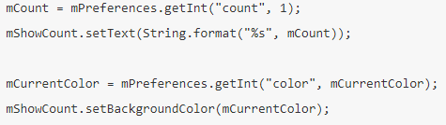
Restoring Shared Preferences

Slide 10
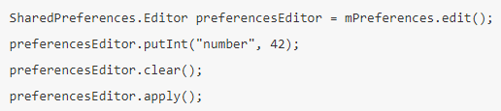
Clearing Shared Preferences
To clear all the values in the shared preferences file, call the clear() method on the shared preferences editor and apply the changes.

Slide 11
Thank you!
Any Questions???

